Slide 1

My Capstone Project
Jon Phillips
Deep Dive IoT Boot Camp Cohort 11

Slide 2
A little about me
Name: Jon Phillips
Age: 45 years old
Work History of Corrections and Driving Truck
Spinal Injury ended ability to continue in career
Decided to return to school

Slide 3
A little about me
Attending CNM studying Computer Programming
STEMCore summer bridge program
IoT Boot Camp
Goal is career in the design and manufacture of robotics

Slide 4
Deciding on a project
Wanted to do something that could help make the world a better place
Considered many problems that the world is currently facing
Decided on something to help protect our children
Average of 40 children per year die from being left unattended in a car. ( according to the NY times )

Slide 5

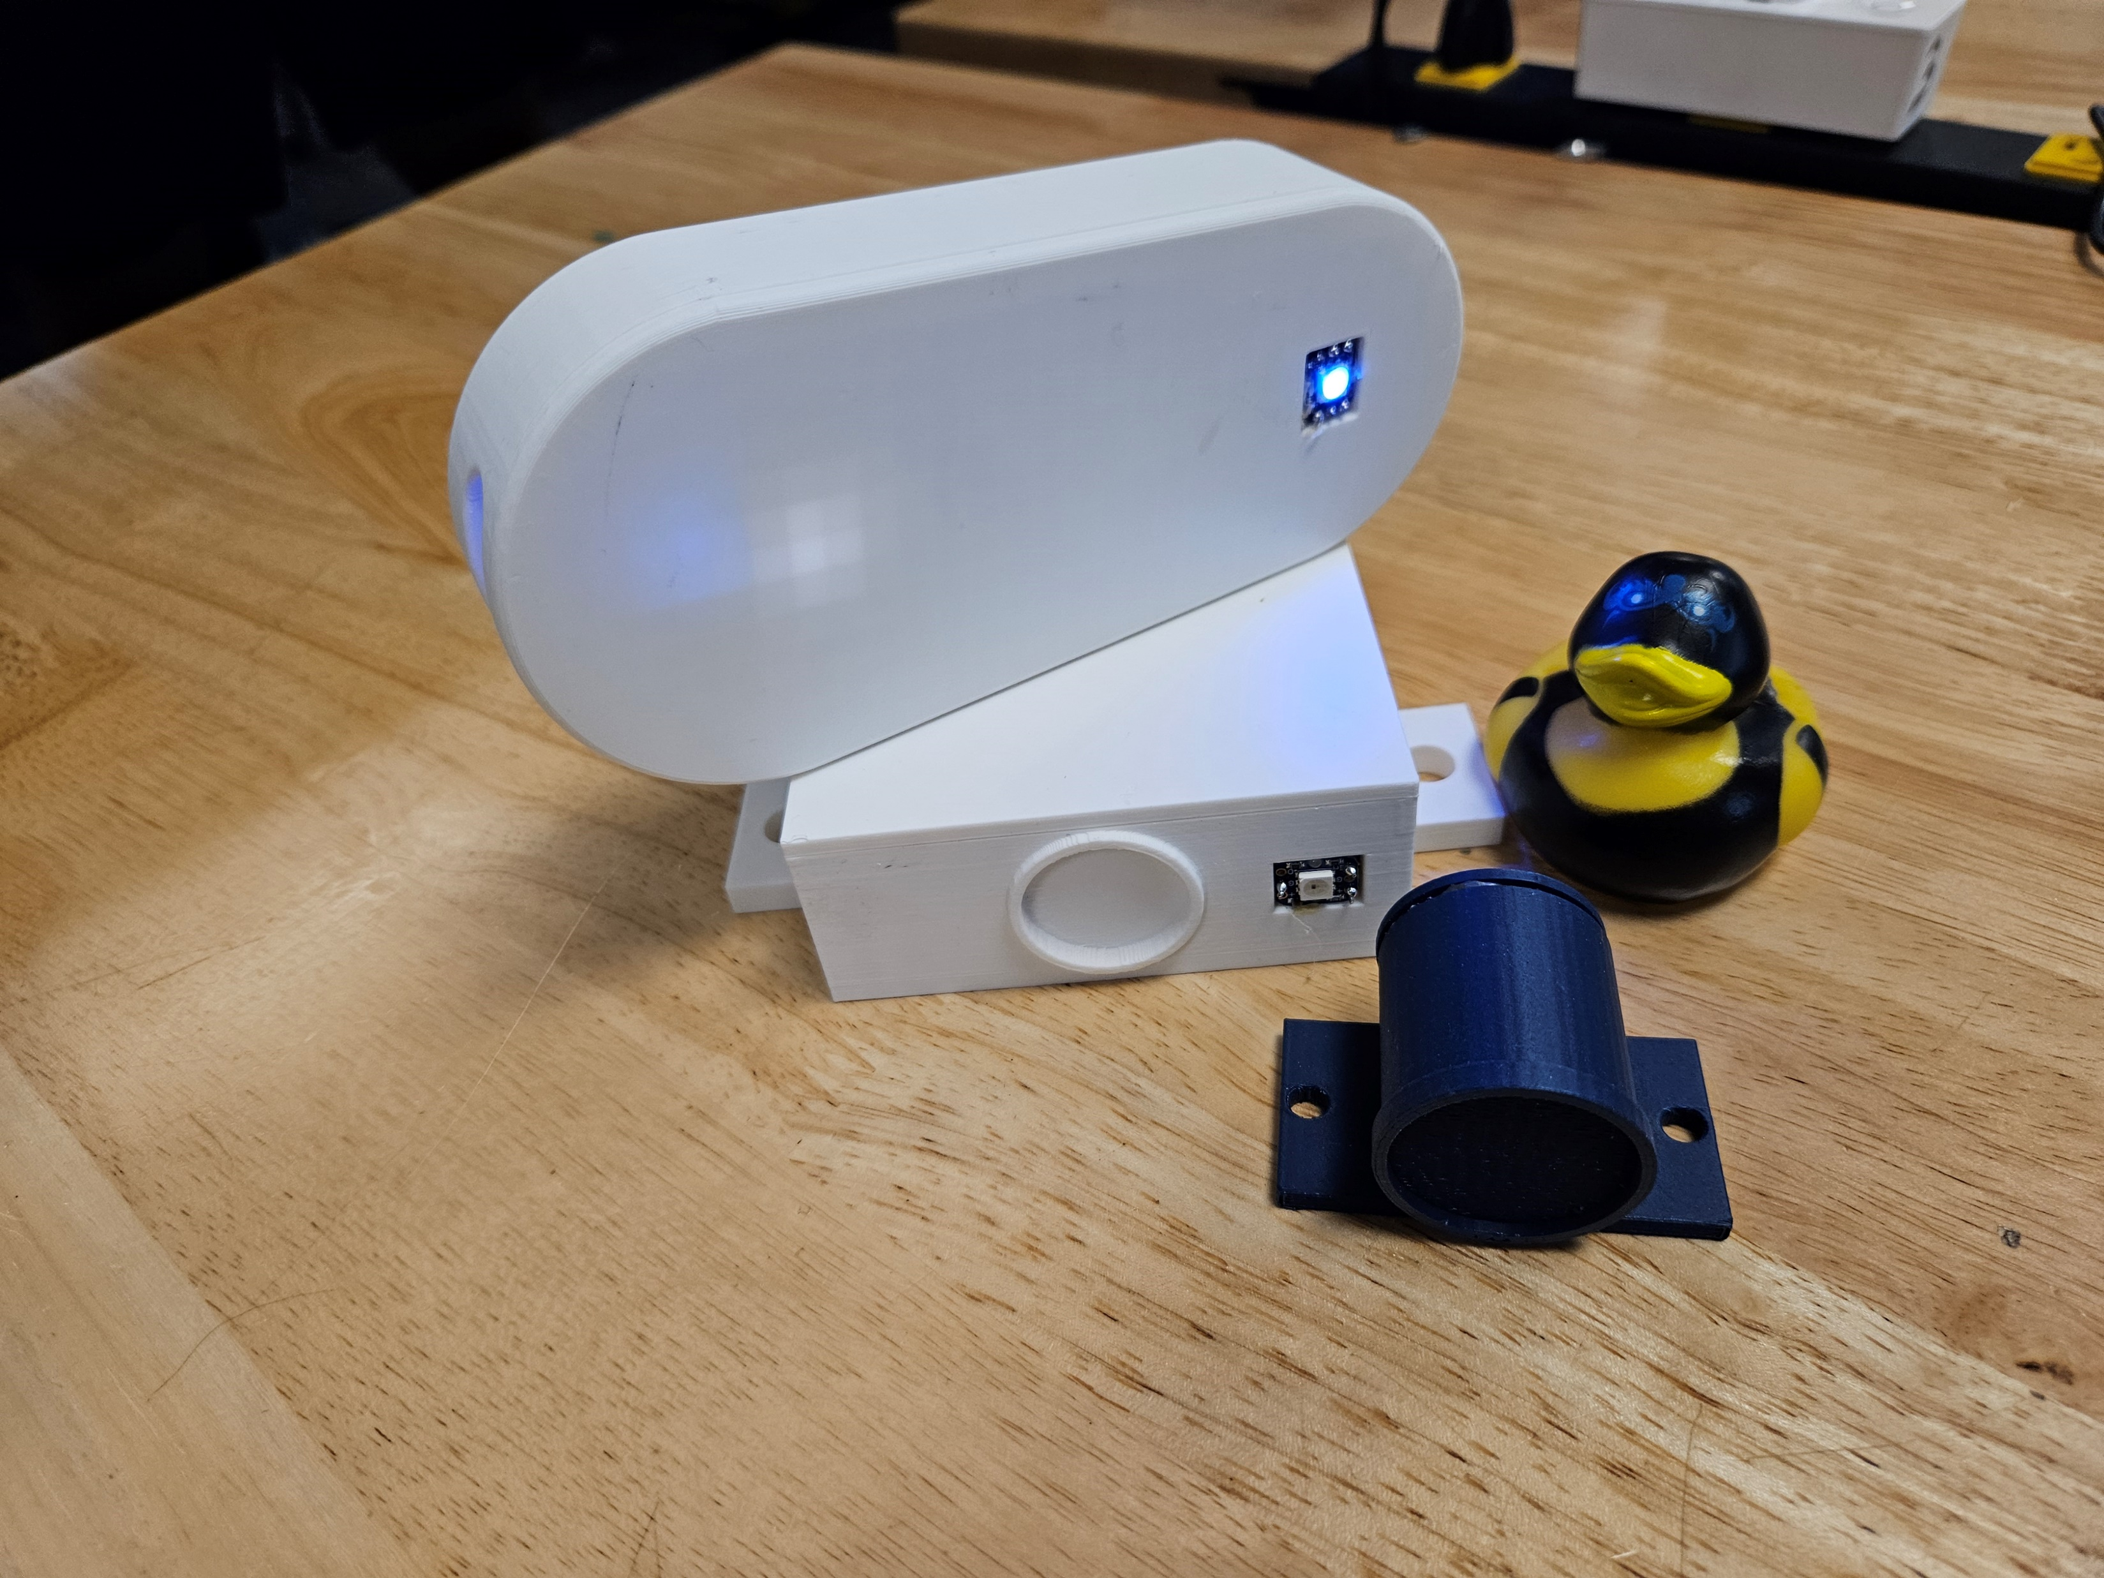
SafeChild Car Seat Monitoring System
Deciding on a project

Slide 6
Here’s how it works Please keep in mind this is a proof-of-concept model for prototyping purposes and the parts are much larger than they would be in a completed product

Slide 7
Consists of three separate pieces

Slide 8
Consists of three separate pieces

Slide 9
Consists of three separate pieces

